Slide 1
INTRODUCTION

Slide 2
Introduction
Computational Thinking
Knowledge of using computers to perform our day-to-day
Eg: airline reservation, video surveillance, biometric recognition, e-governance & e-commerce
Algorithmic Thinking
Important analytical skill that is required for writing effective programs in order to solve given problems
The knowledge of how to solve a problem

Slide 3
Introduction
Algorithmics
Art of designing, implementing, and analysing algorithms
Algorithm
An algorithm is a set of unambiguous instructions or procedures used for solving a given problem to provide correct and expected outputs for all valid and legal input data

Slide 4
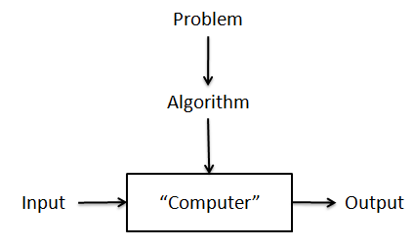
Algorithm
The range of inputs for which an algorithm works has to be specified carefully.
The nonambiguity requirement for each step of an algorithm cannot be compromised.
The same algorithm can be represented in several different ways.
Several algorithms for solving the same problem may exist.
Algorithm for the same problem can be based on very different ideas and can solve the problem with dramatically different speeds.

Slide 5
Problem
Types of Problem
Computational problems
Can be solved by a computer system
The formalization of all legal inputs and expected outputs of a given problem
The characterization of the relationship between problem output and input.
Non-computational problems
Cannot be solved by a computer system
There is no algorithm that can be used to solve it

Slide 6
Types of computational problems
Structuring problems
The input is restructured based on certain conditions or properties.
Ex: sorting a list in an ascending or a descending order is a structuring problem.
Search problems
Searching for a target in a list of all possibilities.
Ex : Puzzles
Construction problems
These problems involve the construction of solutions based on the constraints associated with the problem.

Slide 7
Types of computational problems
Decision problems
Decision problems are yes/no type of problems where the algorithm output is restricted to answering yes or no
Optimization problems
Based on a set of constraints that are associated with the problem
Eg : Shortest distance between two cities
Involve a certain objective function of form: maximize (say profit) or minimize (say effort)

Slide 8
Algorithm
Characteristics of Algorithm
Input : zero or more input
Output : at least one or more output
Definiteness : instruction should be clear
Uniqueness : well-defined and ordered
Correctness : correct
Effectiveness : should be traceable manually
Finiteness : finite steps and should terminate after execution
Simplicity : easy of implementation
Generality : able to handle all range of input

Slide 9
Need for Algorithm
Computer resource are limited
Ex : travelling salesman problem
No. of Cities | No. of routes
1 | 0
2 | 1
3 | 2
4 | 6
5 | 24
6 | 120
A
A
B
A
B
C

Slide 10
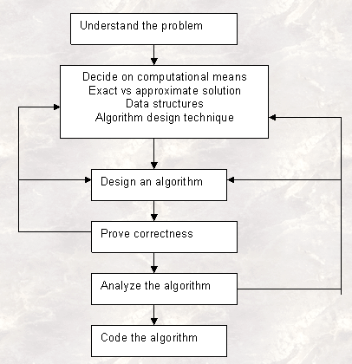
Algorithm Design and Analysis process

Slide 11
Algorithm Design and Analysis process
Understand the problem
The problem given should be understood completely.
Check if it is similar to some standard problems & if a known algorithm exists.
Otherwise a new algorithm has to be devised.
Creating an algorithm is an art which may never be fully automated.
An important step in the design is to specify an instance of the problem.
Deciding on computational mean
Once a problem is understood we need to Know the capabilities of the computing device this can be done By Knowing the type of the architecture, speed & memory availability.

Slide 12
Algorithm Design and Analysis process
Deciding on Exact vs. Approximate problem solving
Once algorithm is devised, it is necessary to show that it computes answer for all the possible legal inputs.
The solution is stated in two forms: Exact solution or approximate solution.
Examples of problems where an exact solution cannot be obtained are i)Finding a square root of number. ii) Solutions of non linear equations.
Decide on the appropriate data structure
Some algorithms do not demand any ingenuity in representing their inputs.
Some others are in fact are predicted on ingenious data structures.
Algorithm + Data Structure = Program

Slide 13
Algorithm Design and Analysis process
Design an Algorithm
General approach to solving problems algorithmically that is applicable to a variety of problems from different areas of computing
Some important design techniques are linear, non linear and integer programming
Methods of specifying an algorithm: natural language or pseudocode & Flowcharts.
A Pseudo code is a mixture of natural language & programming language like constructs.
A flowchart is a method of expressing an algorithm by a collection of connected geometric shapes.
Prove Correctness
The process of validation means checking whether the algorithm gives the correct result or not
The process of verification is a process of providing a mathematical proof that the given algorithm works correctly for all instances of data.
A complete proof of program correctness requires that each statement of programming language be precisely defined and all basic operations be proved correct.

Slide 14
Algorithm Design and Analysis process
Analyzing an Algorithm
The task of determining how much computing time and storage an algorithm requires.
Time efficiency : how fast the algorithm runs
Space efficiency : how much extra memory the algorithm needs
Requires great mathematical skill and simplicity
Coding an Algorithm
Most algorithms are implemented as computer program
The validation of program is established by testing.
Test and debug your program thoroughly whenever you implement an algorithm.
As a rule, a good algorithm is a result of repeated effort and rework.

Slide 15
Classification of Algorithm
Based on Implementation
Recursive vs Non-Recursive algorithms
Nature and Number of Processors
Sequential algorithm
Parallel algorithm
Exact vs Approximation Algorithms
Deterministic vs Non-Deterministic Algorithm
Based on Design
Brute force
Divide and Conquer
Dynamic Programming
Greedy Approach
Backtracking
Branch and Bounce

Slide 16
Classification of Algorithm
Based on Area of Specialization
General Algorithm
Sorting algorithms
Domain specific specialization algorithm
String algorithms
Graph algorithms
Travelling salesperson problem / Chinese postman problem / Graph colouring problem
Combinatorial algorithms
Geometric algorithms
Closest pair problem / convex hull problem
Based on Tractability
Easily solvable problems
Unsolvable problems
Intractable problems

Slide 17
Tools for Problem Solving
Top-down approach
Problem solving starts from a given global problem to its subproblems
Efficiency : depends on quality of division process
More redundant computations
Testing is difficult
Bottom-up Approach
Problem solving starts from subproblems of the given problem to the global problem
Efficiency : depends on composition process
Uses the concept of reuse
Testing is easy
Structured Programming
Sequence
Selection
Iteration

Slide 18
Algorithm
General template
Algorithm Name (Parameters)
%% Input : Description of the input
%% Output : Description of the output
Begin
…….
…..
End
Example
GCD(a, b)
%% Input : two numbers a and b
%% Output : GCD of a and b
Begin
x = max(a,b)
y = min(a,b)
while (y != 0) do
Begin
r = x mod y
x = y
y = r
End
End while
return x
End

Slide 19
Non – Recursive Algorithm
Do not use the concept of recursion
Use looping construct such as for/while or repeat-until to create iteration or repetion of tasks
Only for simple problem

Slide 20
Recursive Algorithm
Performing repetition of tasks
Alternate way of creating iteration in programs
Concept of self- reference
Component
Base case
Initial value
The point where the solution to a problem is known
Non recursive part
Recursive case
Inductive part
Rule that gives a solution to a problem in terms of its subproblems

Slide 21
Recursive Algorithm
Criteria | Recursion | Iteration
Termination | Terminates when the base condition is reached | When the condition is false
Space | Extra space in the form of stack space is required for recursion | No additional space is required
Stack overflow | Repeated calls require more memory space and may cause stack overflow | No such situation arises
Formulation | Easier to formulate | Not easy as recursion
compactness | Simple and compact | Not compact as recursion

Slide 22
Recursive Algorithm
Types
Direct and indirect Recursion
Direct : function calls itself
Indirect : function calls another function
Linear and Non-Linear Recursion
Linear : no pending operation
Non linear : recursive call result in tree like structure
Tail and Non-tail Recursion
Tail : last statement of an algorithm is recursive call
Non tail : pending operation /additional statement
Binary and Exponential Recursion
Binary : 2 recursive function calls
Exponential : number of recursive call increases exponentially

Slide 23
Algorithm Correctness
Algorithm validation means checking whether the algorithm gives the correct result or not
Algorithm verification is a process of providing a mathematical proof that the given algorithm works correctly for all instances of data.
Assertions
Logical expression that asserts a condition
Ex : x > 0
Two key assertion
Precondition
Postcondition

